Slide 1

TITLE:TYPING SPEED TESTER
SUBTTILE: A simple program to measure Typing Speed
PRESENTED BY: MUHAMMAD ALI CHEEMA & ABDULREHMAN

Slide 2

Introduction
WHAT IS TYPING SPEED?
DEFINITION: The rate at which a person can type text is known as typing speed.
IMPORTANCE: It is useful for improving productivity and efficiency in typing tasks.

Slide 3
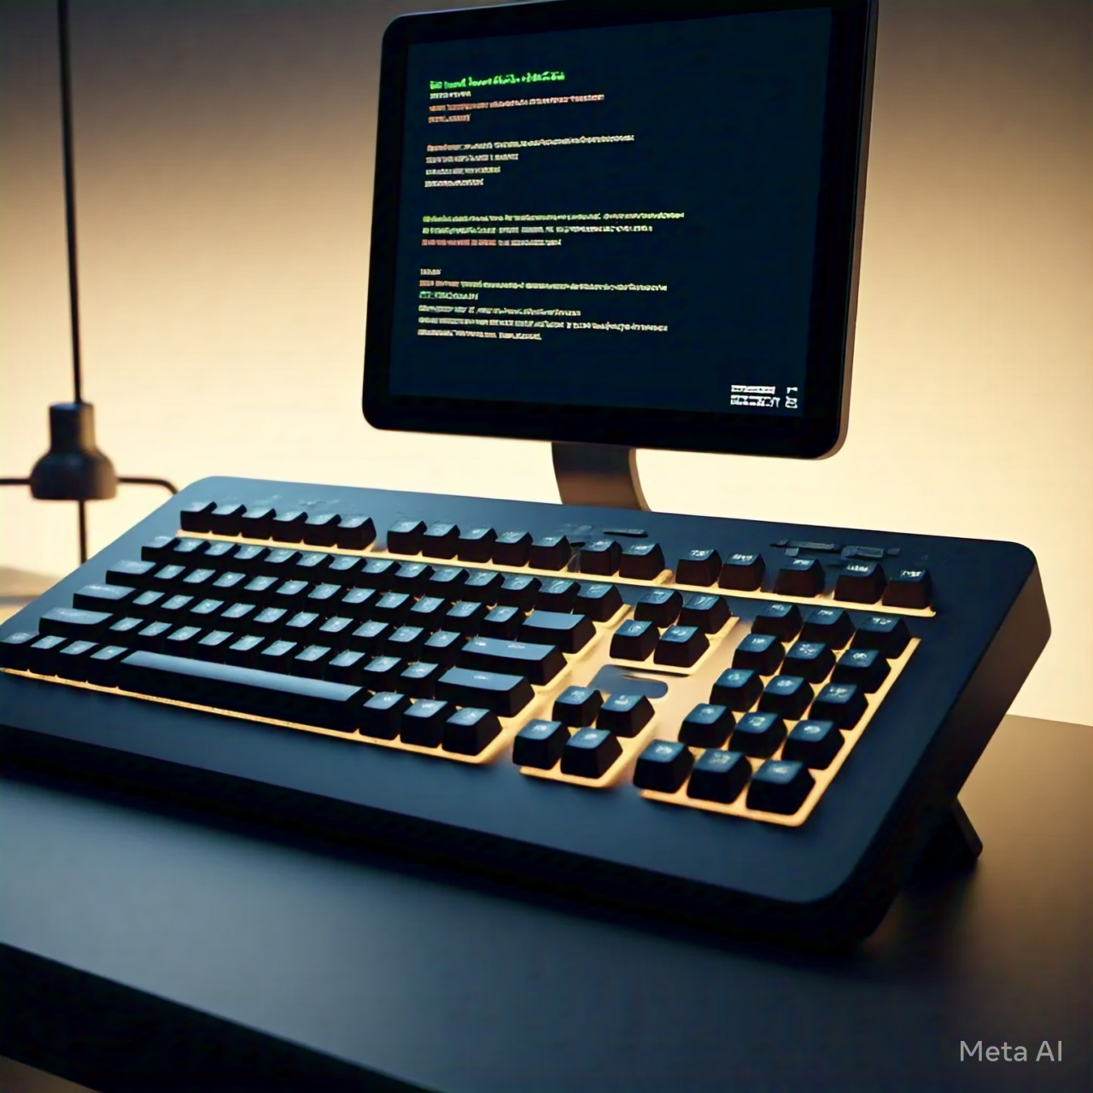
OBJECTIVES
To measure the typing speed of users.
To provide feedback on accuracy and speed.
To help users improve their typing skills.

Slide 4
Code Structure
Header Files:
#include <iostream>,
#include <string>,
#include <ctime>, etc.
Functions
generateText()
startTimer()
calculateWPM()
displayResults()

Slide 5
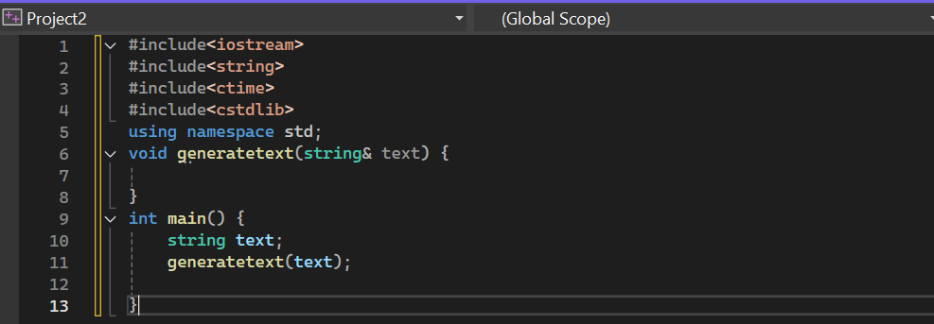
SAMPLE CODE SNIPPET

Slide 6
HOW IT WORKS
The program generates a random sentence or paragraph.
The user is prompted to type the text.
The timer starts when the user begins typing.
Once the user finishes, the timer stops, and results are calculated.

Slide 7
Calculating Typing Speed
Words Per Minute (WPM) Calculation
Formula: WPM = (Number of Words Typed / Time in Minutes)
Example: If a user types 50 words in 1 minute, WPM = 50.

Slide 8

Accuracy Calculation
Formula: Accuracy = (Correct Words / Total Words) * 100
Example: If 45 out of 50 words are correct, Accuracy = 90%.

Slide 9

User Interface
Clear instructions on how to use the program.
Display of results in a user-friendly format.

Slide 10

CONCLUSION
The Typing Speed Tester is a simple yet effective tool for improving typing skills.
Encourages practice and provides measurable feedback.

Slide 11


